Slide 1


M.A.M. COLLEGE OF ENGINEERING AND TECHNOLOGY
Siruganur, Tiruchirappalli – 621 105.
IOT BASED SECURITY DETECTION CAMERA
Roll no | Name
CS22B016 | Bharathy Cahgla
CS22B023 | Farjana Farvin.S
Notes:
Notes for Teachers:
The Synopsis presentation should contain 1. Real life applications 2. Overview of the subject 3. PO’s CO’s of the course 4. Individual Units overview 5. Lesson Plan 6. Flip Class topics
“ Be professionally dressed and use a QUALITY PEN. Never hand an ordinary PEN as a Cosmetic Effect”

Slide 2
ABSTRACT
The technology of internet of things (IOT) has been used to develop numerous application .
This presentation comprises design of camera integrated with the IOT feature in order to monitor and control system’s parameter from any place around the world.

Slide 3
HARDWARE REQUIREMENTS
Raspberry Pi development board
UVC (Universal video class) driver camera
IR sensor

Slide 4
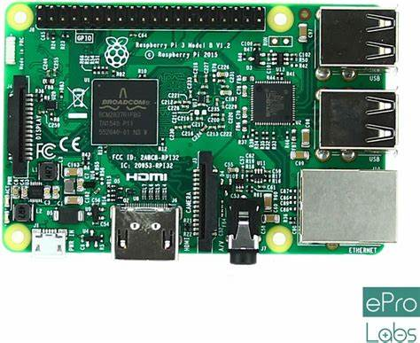
RASPBERRY PI BOARD

Slide 5
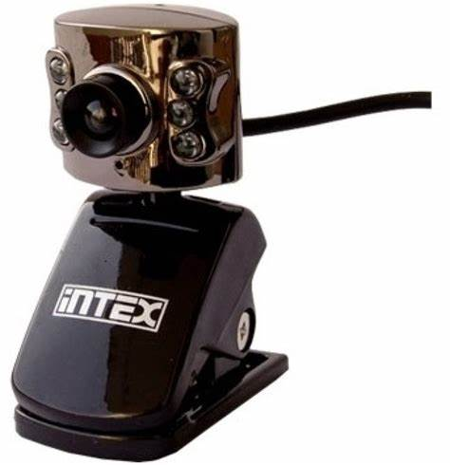
UVC

Slide 6
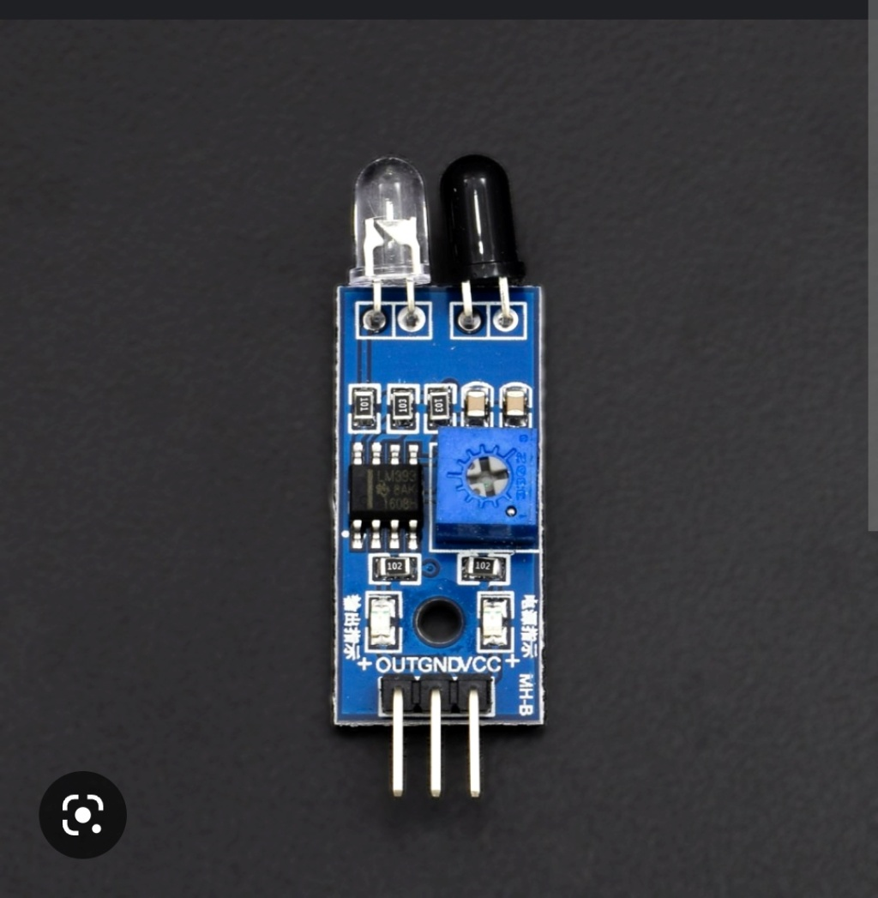
IR SENSOR

Slide 7
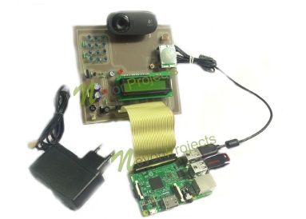
IMAGE OF THE SECURITY DETECTION CAMERA

Slide 8
SOFTWARE REQUIREMENTS
LINUX operating system
Python
Jupyter
Open CV

Slide 9
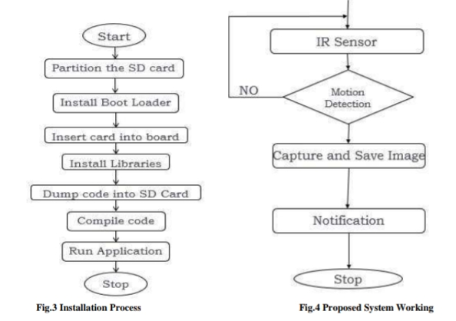
BLOCK DIAGRAM

Slide 10

Source code
https://www.onlinegdb.com/edit/6lNr2iUR6

Slide 11
Applications
Camera Based Surveillance System Using Raspberry Pi is mainly beneficial for determining crime, It monitors scenarios and activities, helpful for gathering evidences and detecting thefts instantly.
The system is built to monitor home, offices and detect theft as soon as it takes place.

Slide 12

ADVANTAGES
It is low cost.
It has high resolution

Slide 13
Conclusion
The project IOT based on the theft detection using Raspberry Pi has demonstrated how to get a fully functional embedded product developed from scratch.
This included the cross compilation and deployment of essential libraries , the configuration of embedded LINUX and CLOUD computing technology.
This system is suitable for small personal area surveillance ex: personal office cabin, bank locker room, parking entrance

Slide 14
